Slide 1
VA QUERI Showcase Webinar
Innovative Implementation Programs Across Three QUERI Initiatives
EMPOWER 3.0
CARE-VASH
iTRIP
Enhancing Mental & Physical
Health of Women through
Engagement & Retention
Coordinated Access for Addiction
Recovery & Equity in VA
Supportive Housing
Innovative Treatments for
Recovery Implementation
Program
Principal Investigators
Principal Investigators
Principal Investigators
Alison Hamilton, PhD, MPH
Bevanne Bean-Mayberry, MD, MHS
Melissa Farmer, PhD
Erin Finley, PhD, MPH
Sonya Gabrielian, MD
Evelyn Chang, MD
Erin Finley, PhD, MPH
Emily Treichler, PhD
James Pittman, PhD, LCSW
Borsika Rabin, PhD, MPH, PharmD

Slide 2
Session Agenda
TIME
TOPIC
PRESENTER(S)
FOCUS
0:00 – 0:02
Welcome & Logistics
Borsika Rabin
0:02 – 0:07
QUERI Program Overview
Borsika Rabin
History, goals, and current landscape
0:07 – 0:17
EMPOWER 3.0
Hamilton
Women's mental & physical health
0:17 – 0:27
CARE-VASH
Gabrielian & Treichler
Addiction recovery & supportive housing equity
0:27 – 0:37
iTRIP
Pittman & Rabin
Innovative Treatments for PTSD & TRD
0:37 – 0:40
QUERI Snapshot: Summary Table
Borsika Rabin
Cross-QUERI comparison
0:40 – 1:00
Open Discussion & Q&A
All
Audience questions and panel dialogue
Notes:
I listed initially all MPIs here but we only coordinated for time with Alison, Sonya, Emily, James, and me. I assume we can remove the rest of the team for this presentation?

Slide 3
About the QUERI Program
The Quality Enhancement Research Initiative (QUERI) is a VA national program launched in 1998 to bridge the gap between research and clinical practice — systematically translating evidence-based findings into improved care for Veterans.
VA’s Quality Enhancement Research Initiative (QUERI) leverages innovative methods—paired with a deep understanding of Veterans’ preferences and needs—to accelerate evidence into practice and improve the quality and safety of care delivered to Veterans.
Mission: Implement evidence-based practices (EBPs) into routine VA care through rigorous implementation science, accelerating benefit to Veterans at scale.
1998
16
Year Founded
Active QUERIs
How QUERI Works
Partners researchers with VA operational leaders
Uses implementation science frameworks (e.g., CFIR, RE-AIM)
Embeds within VA Learning Health System infrastructure
Targets health conditions with highest Veteran burden
Produces scalable, reusable implementation toolkits
QUERI Strategic Methodology
(1) Implement and sustain effective practices across various health settings, especially in sites with demonstrated gaps in quality or outcomes.
(2) Conduct rigorous evaluations in partnership with national and regional health system leaders to optimize programs and policies affecting Veterans.
(3) Promote the application of implementation and quality improvement science to real world practice across the translation spectrum.
6M+
400+
Veterans Served by VA
Experts in Health Services
Today's Featured QUERIs
EMPOWER 3.0 · CARE-VASH · iTRIp

Slide 4
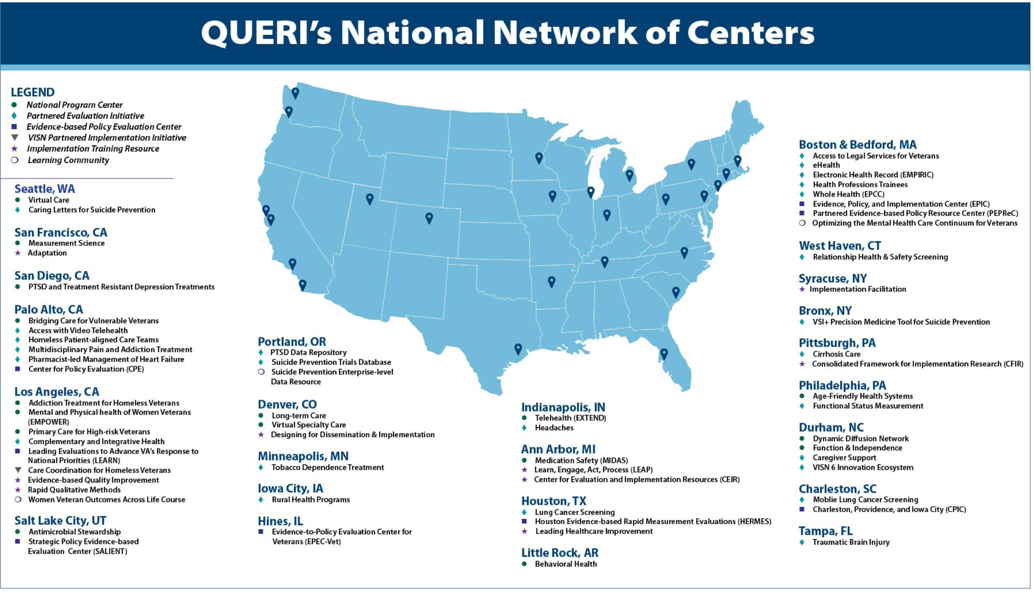

Slide 5

EMPOWER 3.0
Enhancing Mental and Physical Health of Women through Engagement and Retention
[PLACEHOLDER — Presenter Content]
Impact Goal
Principal Investigators
To optimize women Veterans’ access to and quality and experience of care by offering trauma-informed, evidence-based interventions that meet high-priority health needs in midlife, and thereby, to increase women Veterans’ trust, well-being, and engagement in VA care.
Alison Hamilton, PhD, MPH
Bevanne Bean-Mayberry, MD, MHS
Melissa Farmer, PhD
Erin Finley, PhD, MPH
Duration
10 minutes
QUE 25-015

Slide 6

EMPOWER 3.0
Enhancing Mental and Physical Health of Women through Engagement and Retention
[PLACEHOLDER — Presenter Content]
Background
Women Veterans are the fastest-growing segment of VA users
Almost half of women Veterans using VA are in midlife (aged 45-64), during which the risk of chronic disease increases and menopause typically occurs
Trust in VA remains a critical issue
Only 40% of women in VA care report “complete trust” in their VA provider
Provider communication, care appropriate to women, and trauma-sensitive communication assoc w/ greater patient trust
Challenging experiences drive attrition from VA, whereas favorable experiences (e.g., of appropriate care) drive retention
Carlson GC, et al. What drives women veterans’ trust in VA healthcare providers?. Women's Health Issues. 2022 Sep 1;32(5):499-508.
Chanfreau-Coffinier C, et al. Mental health screening results associated with women veterans' ratings of provider communication, trust, and care quality. Women's Health Issues. 2018 Sep 1;28(5):430-8.
Chrystal JG, et al. Women veterans’ attrition from the VA Health Care System. Women's Health Issues. 2022 Mar 1;32(2):182-93.

Slide 7
EMPOWER 3.0
Enhancing Mental and Physical Health of Women through Engagement and Retention
[PLACEHOLDER — Presenter Content]
EMPOWER Background
EMPOWER (2015-2020) implemented cardiovascular risk reduction toolkit, collaborative care for anxiety and depression, and Diabetes Prevention Program (DPP) tailored to women Veterans
EMPOWER 2.0 (2020-2025) implemented virtual preventive interventions: Telephone Lifestyle Coaching, virtual DPP, and Reach Out, Stay Strong Essentials (ROSE)
1+ EBP in 22 sites
EBP Overall staff and providers trained
DPP: 159 staff and providers trained; 73 trained in EBQI
TLC: 52 staff and providers trained; 25 trained in EBQI
ROSE: 241 staff and providers trained; 84 trained in EBQI; 166 trained ROSE facilitators
Enrollment: 740+ women Veterans enrolled in virtual preventive care services
ROSE training in at least 61 non-EMPOWER sites

Slide 8
EMPOWER 3.0
Enhancing Mental and Physical Health of Women through Engagement and Retention
[PLACEHOLDER — Presenter Content]
EMPOWER 3.0 Evidence-Based Practices
Trauma-Informed Care
Brief CBT or Whole Health for Symptoms of Menopause
Women’s MOVE!

Slide 9
EMPOWER 3.0
Enhancing Mental and Physical Health of Women through Engagement and Retention
[PLACEHOLDER — Presenter Content]
EMPOWER 3.0 Research Question & Design
What additional supports do sites need to achieve successful implementation and sustainment of evidence-based practices?
Cluster randomized type 3 hybrid implementation-effectiveness trial design
18 sites across 4 VISNs
(VISN 15, 16, 20, 23)

Slide 10
EMPOWER 3.0
Enhancing Mental and Physical Health of Women through Engagement and Retention
[PLACEHOLDER — Presenter Content]
EMPOWER 3.0 Implementation Strategy: Background
Evidence-Based Quality Improvement (EBQI): QI method for engaging frontline providers in improvement
Introduces strategies for using evidence to guide improvement efforts toward operational goals
Accomplished by interdisciplinary teams who are trained in EBQI
VA Office of Women’s Health has invested in rolling out EBQI in VA women’s health nationally since FY21 (ACHIEVE initiative)
Comparing EBQI Booster to EBQI Booster + External Facilitation at former ACHIEVE sites

Slide 11
EMPOWER 3.0
Enhancing Mental and Physical Health of Women through Engagement and Retention
[PLACEHOLDER — Presenter Content]
EMPOWER 3.0 Next Steps
Year 1
Co-Production
Engaging stakeholders to optimize EBP packaging and delivery
Years 2-5
EBQI Booster (EBQI-B): All 18 sites
EBQI Refresher + Electronic tools and data infrastructure + QI Collaborative
EBQI-B + External Facilitation (EF): 9 sites
Half of sites will also receive EBP-specific EF
Key Evaluation Outcomes
Improved shared decision-making, well-being, and engagement in EBPs; improved VA performance metrics; fidelity to implementation strategy; speed of implementation; recipient satisfaction with EBP implementation; cost of implementation and business case analysis.

Slide 12

CARE-VASH
Coordinated Access for Addiction Recovery and Equity in VA Supportive Housing
[PLACEHOLDER — Presenter Content]
Principal Investigators
CARE-VASH QUERI aims to
optimize equity in access to evidence-based substance use disorder services among Veterans in VA’s permanent supportive housing program.
Sonya Gabrielian, MD
Evelyn Chang, MD
Erin Finley, PhD, MPH
Emily Treichler, PhD
Duration
10 minutes

Slide 13


CARE-VASH
Coordinated Access for Addiction Recovery and Equity in VA Supportive Housing
Stable housing is a critical determinant of health
Sonya Gabrielian, MD
Evelyn Chang, MD
Erin Finley, PhD
Emily Treichler, PhD
Compared to housed Veterans, homeless-experienced Veterans have higher rates of mental illness and substance use disorders (SUDs)
These behavioral health disorders impair Veterans’ ability to attain and retain housing

Slide 14

CARE-VASH
Coordinated Access for Addiction Recovery and Equity in VA Supportive Housing
The Department of Housing and Urban Development-VA Supportive Housing (HUD-VASH) program provides subsidized permanent housing and supportive services
HUD-VASH contributed substantively to the 50% reduction in Veteran homelessness seen over the past decade
Yet, up to 40% of Veterans exit HUD-VASH within 2 years of housing, and SUDs are a common primary or contributing factor to premature HUD-VASH exits
HUD-VASH
is VA’s largest program in its strategic plan to end Veteran homelessness
Sonya Gabrielian, MD
Evelyn Chang, MD
Erin Finley, PhD
Emily Treichler, PhD

Slide 15

LEARN Evidence-Based Policy Evaluation Center evaluated HUD-VASH for Veterans with SUDs
Sonya Gabrielian, MD
Evelyn Chang, MD
Erin Finley, PhD
Emily Treichler, PhD
Secondary analyses of VA administrative data regarding Veterans who attained housing via HUD-VASH during FY18-FY21 (N=63,939)
Most (66%, n=42,182) Veterans in the program had SUDs
Veterans with SUDs were significantly more likely (Odds Ratio = 1.5) to have a negative exit from HUD-VASH within one year of move-in

Slide 16

CARE-VASH
Coordinated Access for Addiction Recovery and Equity in VA Supportive Housing
In HUD-VASH, SUDs are associated with Emergency Department
and mental health service use
Sonya Gabrielian, MD
Evelyn Chang, MD
Erin Finley, PhD
Emily Treichler, PhD
In logistic regression analyses, adjusting for demographics and co-morbidity, Veterans with SUDs had higher rates of Emergency Department use, outpatient mental health visits, and inpatient psychiatry admissions in the year after move-in
 | Emergency Department | Primary Care | Outpatient Mental Health, excluding SUD visits | Inpatient Psychiatry
+ SUD (AOR, p-value) | 1.5 p <0.001 | 0.99 p=0.715 | 1.7 p <0.001 | 10.1 p <0.001

Slide 17

CARE-VASH
Coordinated Access for Addiction Recovery and Equity in VA Supportive Housing
Receipt of Evidence-based Practices (EBPs) are low among
HUD-VASH Veterans with SUDs
Sonya Gabrielian, MD
Evelyn Chang, MD
Erin Finley, PhD
Emily Treichler, PhD
<0.5% of HUD-VASH Veterans with amphetamine use disorder received Cognitive Behavioral Therapy – Substance Use Disorders (CBT-SUD)
Enhancing adoption of Medications for Addiction Treatment (MAT) may improve substance use and housing outcomes for Veterans with alcohol and opioid use disorders.
Treatment | n = 33,942 (53% of total)
Alcohol use disorder (AUD) MAT (with topiramate) | 3,867 (11.4%)
Treatment | n = 10,467 (16.4% of total)
Opioid use disorder (OUD) MAT | 2,083 (19.9%)

Slide 18
CARE-VASH
Coordinated Access for Addiction Recovery and Equity in VA Supportive Housing
Sonya Gabrielian, MD
Evelyn Chang, MD
Erin Finley, PhD
Emily Treichler, PhD
National implementation of Evidence-based Practices (EBPs) for Substance Use Disorders (SUDs) within HUD-VASH would advance VA’s commitment to end Veteran homelessness

Slide 19
CARE-VASH
Coordinated Access for Addiction Recovery and Equity in VA Supportive Housing
CARE-VASH QUERI will implement MAT and CBT-SUD at 12 HUD-VASH sites in 3 VISNs
EBP #1:
Medications for Addiction Treatment (MAT) for alcohol and opioid use disorders
Implemented among HUD-VASH teams with an embedded prescriber OR Veteran could be linked to behavioral health care
EBP #2:
Cognitive Behavioral Therapy for Substance Use Disorders (CBT-SUDs)
Many VA mental health clinicians are trained to deliver CBT-SUD, but fewer HUD-VASH case managers are trained
We will train HUD-VASH case managers in CBT-SUD

Slide 20

MAT for alcohol and opioid use disorders
Medications for alcohol use disorders (MAUD) and medications for opioid use disorders (MOUD) are ongoing implementation priorities for OMH, but have not been implemented in HUD-VASH
MAUD: naltrexone and acamprosate
Across meta-analyses and systematic reviews, MAUD significantly decreases alcohol consumption versus placebo
MOUD: methadone, buprenorphine, extended-release naltrexone
In meta-analyses, these medications are more effective than placebo and non-pharmacologic treatments
Reduce mortality, opioid-related overdoses, acute care use
Sonya Gabrielian, MD
Evelyn Chang, MD
Erin Finley, PhD
Emily Treichler, PhD

Slide 21
CBT-SUDs
Evidence-based psychotherapy that is effective across SUDs, improving frequency and quantity of use
Sonya Gabrielian, MD
Evelyn Chang, MD
Erin Finley, PhD
Emily Treichler, PhD
Duration | 12-16 sessions, 45-60 minutes each
Context | Individual or group sessions, in-person or virtual, delivered by a trained therapist, at-home assignments between sessions
Theoretical underpinning | Social learning applied to cognitive behavioral therapy. SUDs develop from reinforcing but maladaptive interactions among thoughts, emotions, and substances

Slide 22
Our project will compare the impacts of two implementation strategies
MAT and CBT-SUD Implementation
[12 sites]
Sonya Gabrielian, MD
Evelyn Chang, MD
Erin Finley, PhD
Emily Treichler, PhD
Implementation Strategies
Training and Technical Assistance
[6 sites]
Training and Technical Assistance
+
Consumer engagement (CE)
[6 sites]
Key evaluation outcomes: MAT and CBT-SUD use; Veteran housing stability
and acute care use, Veteran and provider experiences; costs and budget impact

Slide 23
CARE-VASH
Coordinated Access for Addiction Recovery and Equity in VA Supportive Housing
Sonya Gabrielian, MD
Evelyn Chang, MD
Erin Finley, PhD
Emily Treichler, PhD
The training and technical strategy does not address knowledge and motivation gaps that may impede Veterans from engaging in EBPs for SUDs

Slide 24
CARE-VASH
Coordinated Access for Addiction Recovery and Equity in VA Supportive Housing
We plan a cluster randomized trial to assess our evaluation outcomes
 | Year 1 | Year 2 |  |  |  | Year 3 |  |  |  | Year 4 |  |  |  | Year 5
 | Q4 | Q1 | Q2 | Q3 | Q4 | Q1 | Q2 | Q3 | Q4 | Q1 | Q2 | Q3 | Q4 | Q1-Q4
Cohort 1 | Prep | Training and technical assistance (TTA) |  |  |  |  |  | Maintenance
Cohort 1 |  | Training and technical assistance |  |  | TTA + Consumer Engagement
Cohort 2 | Usual care |  |  | Prep | Training and technical assistance (TTA) |  |  |  |  |  | Maintenance
Cohort 2 |  |  |  |  | Training and technical assistance (TTA) |  |  | TTA + Consumer Engagement
Cohort 3 | Usual Care |  |  |  |  |  | Prep | Training and technical assistance (TTA) |  |  |  |  |  | Main-tenance
Cohort 3 |  |  |  |  |  |  |  | Training and technical assistance (TTA) |  |  | TTA + Consumer Engagement
Each cohort will have 4 HUD-VASH sites

Slide 25
iTRIP
Pittman & Rabin | 10 min
Innovative Treatments for Recovery Implementation Program
Overview & Background
Principal Investigators
Impact Goal
James Pittman, PhD
Borsika Rabin, PhD, MPH, PharmD
Implement innovative evidence-based treatments for trauma-related conditions and treatment-resistant depression (TRD) to improve Veteran care — addressing VA priorities of suicide prevention, outcomes, access, whole health, quality, value, and efficiency.
VA Priorities Addressed
Why This Matters
~2 million Veterans accessed VA mental health services in 2023
PTSD prevalence: ~15.7% of deployed post-9/11 Veterans
Depression affects ~20% of Veterans post-deployment and is the leading cause of disability
High PTSD-depression comorbidity further increases suicide risk
Access gaps remain, especially for rural and underserved Veterans
Suicide prevention
Outcomes & whole health
Access & efficiency
Equity for rural & underserved Veterans
Quality & value
VA Strategic Plan Obj. 2.1, 2.2, 2.4, 2.5, 3.3
Notes:
James

Slide 26
iTRIP
Pittman & Rabin | 10 min
Innovative Treatments for Recovery Implementation Program
Two Evidence-Based Practices — Across the Spectrum of Acuity
EBP 1: Mantram Repetition Program (MRP)
EBP 2: Ketamine Therapy (KT)
Target population
Target population
Veterans with low/moderate acuity PTSD
Veterans diagnosed with Treatment-Resistant Depression (TRD)
What it is
What it is
Meditation-based approach: silent repetition of a spiritual word, one-pointed attention, slowing down. Whole health, transdiagnostic, low-cost.
Rapid-acting antidepressant (RAAD), FDA-approved for TRD. Reduces depressive symptoms rapidly. Priority for VA Office of Mental Health & Suicide Prevention.
Evidence base
Evidence base
Two large RCTs: large effect-size reductions in PTSD symptoms, improved spiritual well-being, reduced insomnia. Self-directed web-based version (mMRP) also effective.
Multiple meta-analyses: robust rapid antidepressant effects, significant reductions in suicidal ideation. Non-inferior to ECT in large US trial. SMD = −0.89 vs placebo at 24h.
Implementation scope
Implementation scope
12 VA sites
4 VA sites
Notes:
James

Slide 27
iTRIP
Pittman & Rabin | 10 min
Innovative Treatments for Recovery Implementation Program
Implementation Framework, Design, & Strategy Bundle
Guiding Framework: PRISM
Study Design: Randomized Stepped-Wedge
The Practical, Robust Implementation and Sustainability Model (PRISM) guides all phases. PRISM extends RE-AIM with multilevel contextual domains: Intervention Characteristics, Organizational & Veteran Characteristics, Implementation & Sustainability Infrastructure, and External Environment. Used across pre-implementation, implementation, and sustainment to optimize contextual fit and outcomes.
Two separate stepped-wedge studies (one per EBP), each with 4 implementation waves MRP: 12 sites, 3 per wave | Primary outcomes: % Veterans receiving EBP for PTSD; time from referral to first visit KT: 4 sites, 1 per wave | Primary outcome: reduction in suicide risk indicators among Veterans with TRD
4-Component Implementation Strategy Bundle
1
Iterative PRISM Assessment (iPRISM)
2
Modified RPIW
3
Training
4
Blended Facilitation
Structured periodic assessment of EBP-context fit by the implementation team; review, prioritize, and action plan. Used pre-implementation, implementation, and sustainment.
Rapid Process Improvement Workshop. Team-based co-creation of local implementation and sustainment plans. Used at pre-implementation and sustainment.
Customized training for each EBP with didactic and hands-on components. Delivered synchronously; available asynchronously. Led by EBP content experts.
Internal champion + external facilitator from QP team working together. Proven in VA implementation trials. Primary strategy during implementation phase.
Notes:
James

Slide 28
iTRIP
Pittman & Rabin | 10 min
Innovative Treatments for Recovery Implementation Program
Data Collection, Outcomes & What's Next
Multi-method data collection across all phases
Primary Outcomes
PRISM CSI Survey
MRP ↑ % Veterans receiving PTSD EBP · ↓ Referral wait time
Ketamine Therapy ↓ Suicide risk indicators (ED visits, CSSRS+)
↓ Mental health admissions — Veterans with TRD
29-item contextual survey, 3 time points (pre-implementation, implementation, sustainment), up to 10 participants/site
Qualitative interviews
PRISM-guided interviews, diverse roles (leaders, clinicians, frontline staff), deductive + inductive coding
VA administrative data
Current Phase & Next Steps
CDW, MHIS, SAIL, VSA — RE-AIM outcomes including reach, adoption, effectiveness, maintenance
Pre-implementation engagement with site partners
Finalizing site selection with VISN & operational partners
Baseline data collection from CDW underway
iPRISM and Modified RPIW operationalization in progress
Training modules in development for each EBP
Learning community and partner engagement launched
Economic analysis
Budget Impact Analysis: staffing, technology, supply costs; replication costs for scale-up; ROI framing for VA leadership
Adaptation tracking
Real-time REDCap documentation using expanded FRAME framework; impact assessed using RE-AIM outcomes
Notes:
James

Slide 29

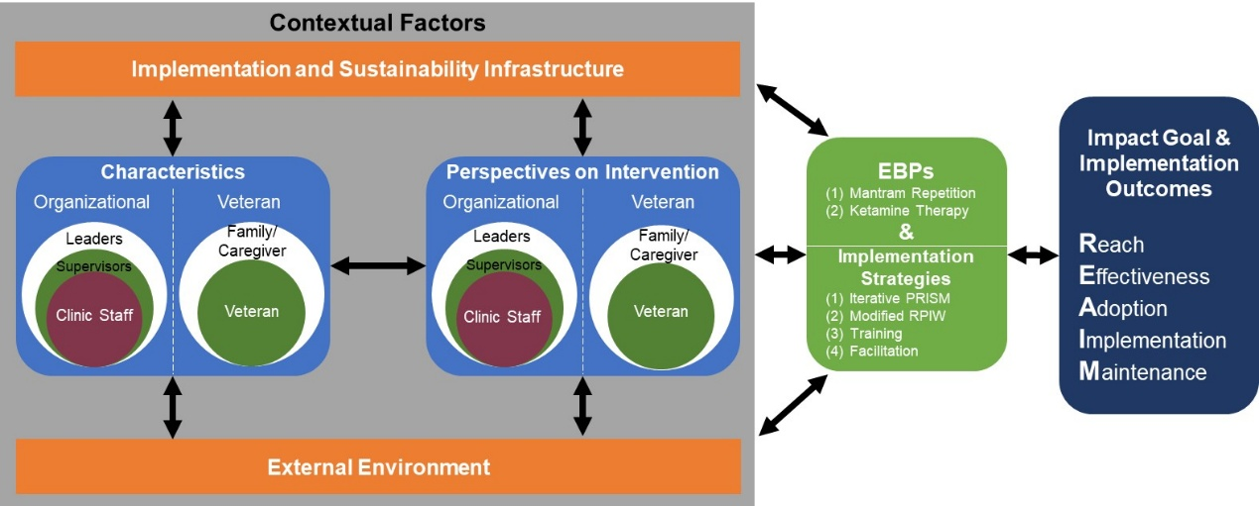
Notes:
Borsika

Slide 30
Stepped-Wedge Design
iTRIP QUERI · Figure 2
iTRIP
Innovative Treatments for Recovery Implementation Program
We employ a randomized stepped-wedge design with four implementation waves for each EBP, enabling robust causal inference while ensuring all sites ultimately receive the intervention. Sites are randomized to implementation timing, with pre-implementation assessment and five total measurement periods capturing clinical outcomes throughout the study.
T0
T1
T2
T3
T4
Year 1
Year 2
Year 3
Year 4
Year 5
1
2
3
4
1
2
3
4
1
2
3
4
1
2
3
4
1
2
3
4
Cohort 1
Finalize sites with
operations partners
& Randomize
Pre-
Impl.
Implementation
Sustainment
Finalize &
Present Sustainment
Phase Deliverables
to Operations Partners
R
T
+
i
i
i
i
+
i
◆
●
★
▲
●
★
●
▲
★
●
◆
●
★
▲
Cohort 2
Pre-
Impl.
Implementation
Sustainment
R
T
+
i
i
i
i
+
i
◆
●
★
▲
●
★
●
▲
★
●
◆
●
★
▲
Cohort 3
Pre-
Impl.
Implementation
Sustainment
R
T
+
i
i
i
i
+
i
◆
●
★
▲
●
★
●
▲
★
●
◆
●
★
▲
Cohort 4
Pre-
Impl.
Implementation
Sustainment
R
T
+
i
i
i
i
+
i
◆
●
★
▲
●
★
●
▲
★
●
◆
●
★
▲
Figure 2. QP stepped-wedge design, implementation activities, and data collection activities.
PHASES
DATA COLLECTION
IMPLEMENTATION STRATEGIES
Control
Pre-Implementation
Implementation
CDW / SAIL / MHIS
★
Survey
i
iPRISM Assessment
R
Modified RPIW
Sustainment
T0–T4 Measurement periods
▲
Interviews
Engagement & Adaptation
T
Training
+
Blended Facilitation (start/end)
Notes:
Borsika

Slide 31
QUERI Snapshot: Cross-Program Comparison
 | EMPOWER 3.0 | CARE-VASH | iTRIP
Key EBPs | Women’s MOVE! Trauma-Informed Care CBT for Menopause Symptoms | Medications for Addiction Treatment Cognitive Behavioral Therapy for SUD | Mantram Repetition Ketamine Therapy
Implementation Strategies | Evidence-Based Quality Improvement (EBQI) Booster with vs. without External Facilitation | Replicating Effective Programs (REP) Consumer Engagement | Rapid Process Improvement Workshop Iterative PRISM Training Facilitation
Key TMF(s) | QUERI Roadmap Health Equity Implementation Framework Life Course Theory | Health Equity Implementation Framework | Practical, Robust Implementation and Sustainability Model (PRISM)
Primary Topics | Cardiovascular risk reduction Menopause Trauma-informed care Trust, well-being, engagement | Increasing equity in access to substance use disorder services Reducing return to homelessness | Suicide prevention Quality, timeliness, equity, and overall experience of mental health care Increased reach
Population Focus | Women Veterans in Midlife | Veterans in Permanent Supportive Housing | Veterans with PTSD and Treatment Resistant Depression
Note: [Add EBPs], [Add strategies], [Add TMF(s)], and [Add topics] cells to be completed by each QUERI team.

Slide 32
Open Discussion & Q&A
~20 minutes
Seed Questions for Discussion
1. How does each QUERI navigate the tension between fidelity to EBPs and local adaptation within the VA?
2. What implementation frameworks or theories have been most useful across these three programs, and why?
3. Where do you see opportunities for cross-QUERI collaboration or shared learning?
Thank you to all presenters and participants!

